Slide 1


Lady: The Special Osprey Summary Analysis
Author: Mohamed Malik

Slide 2
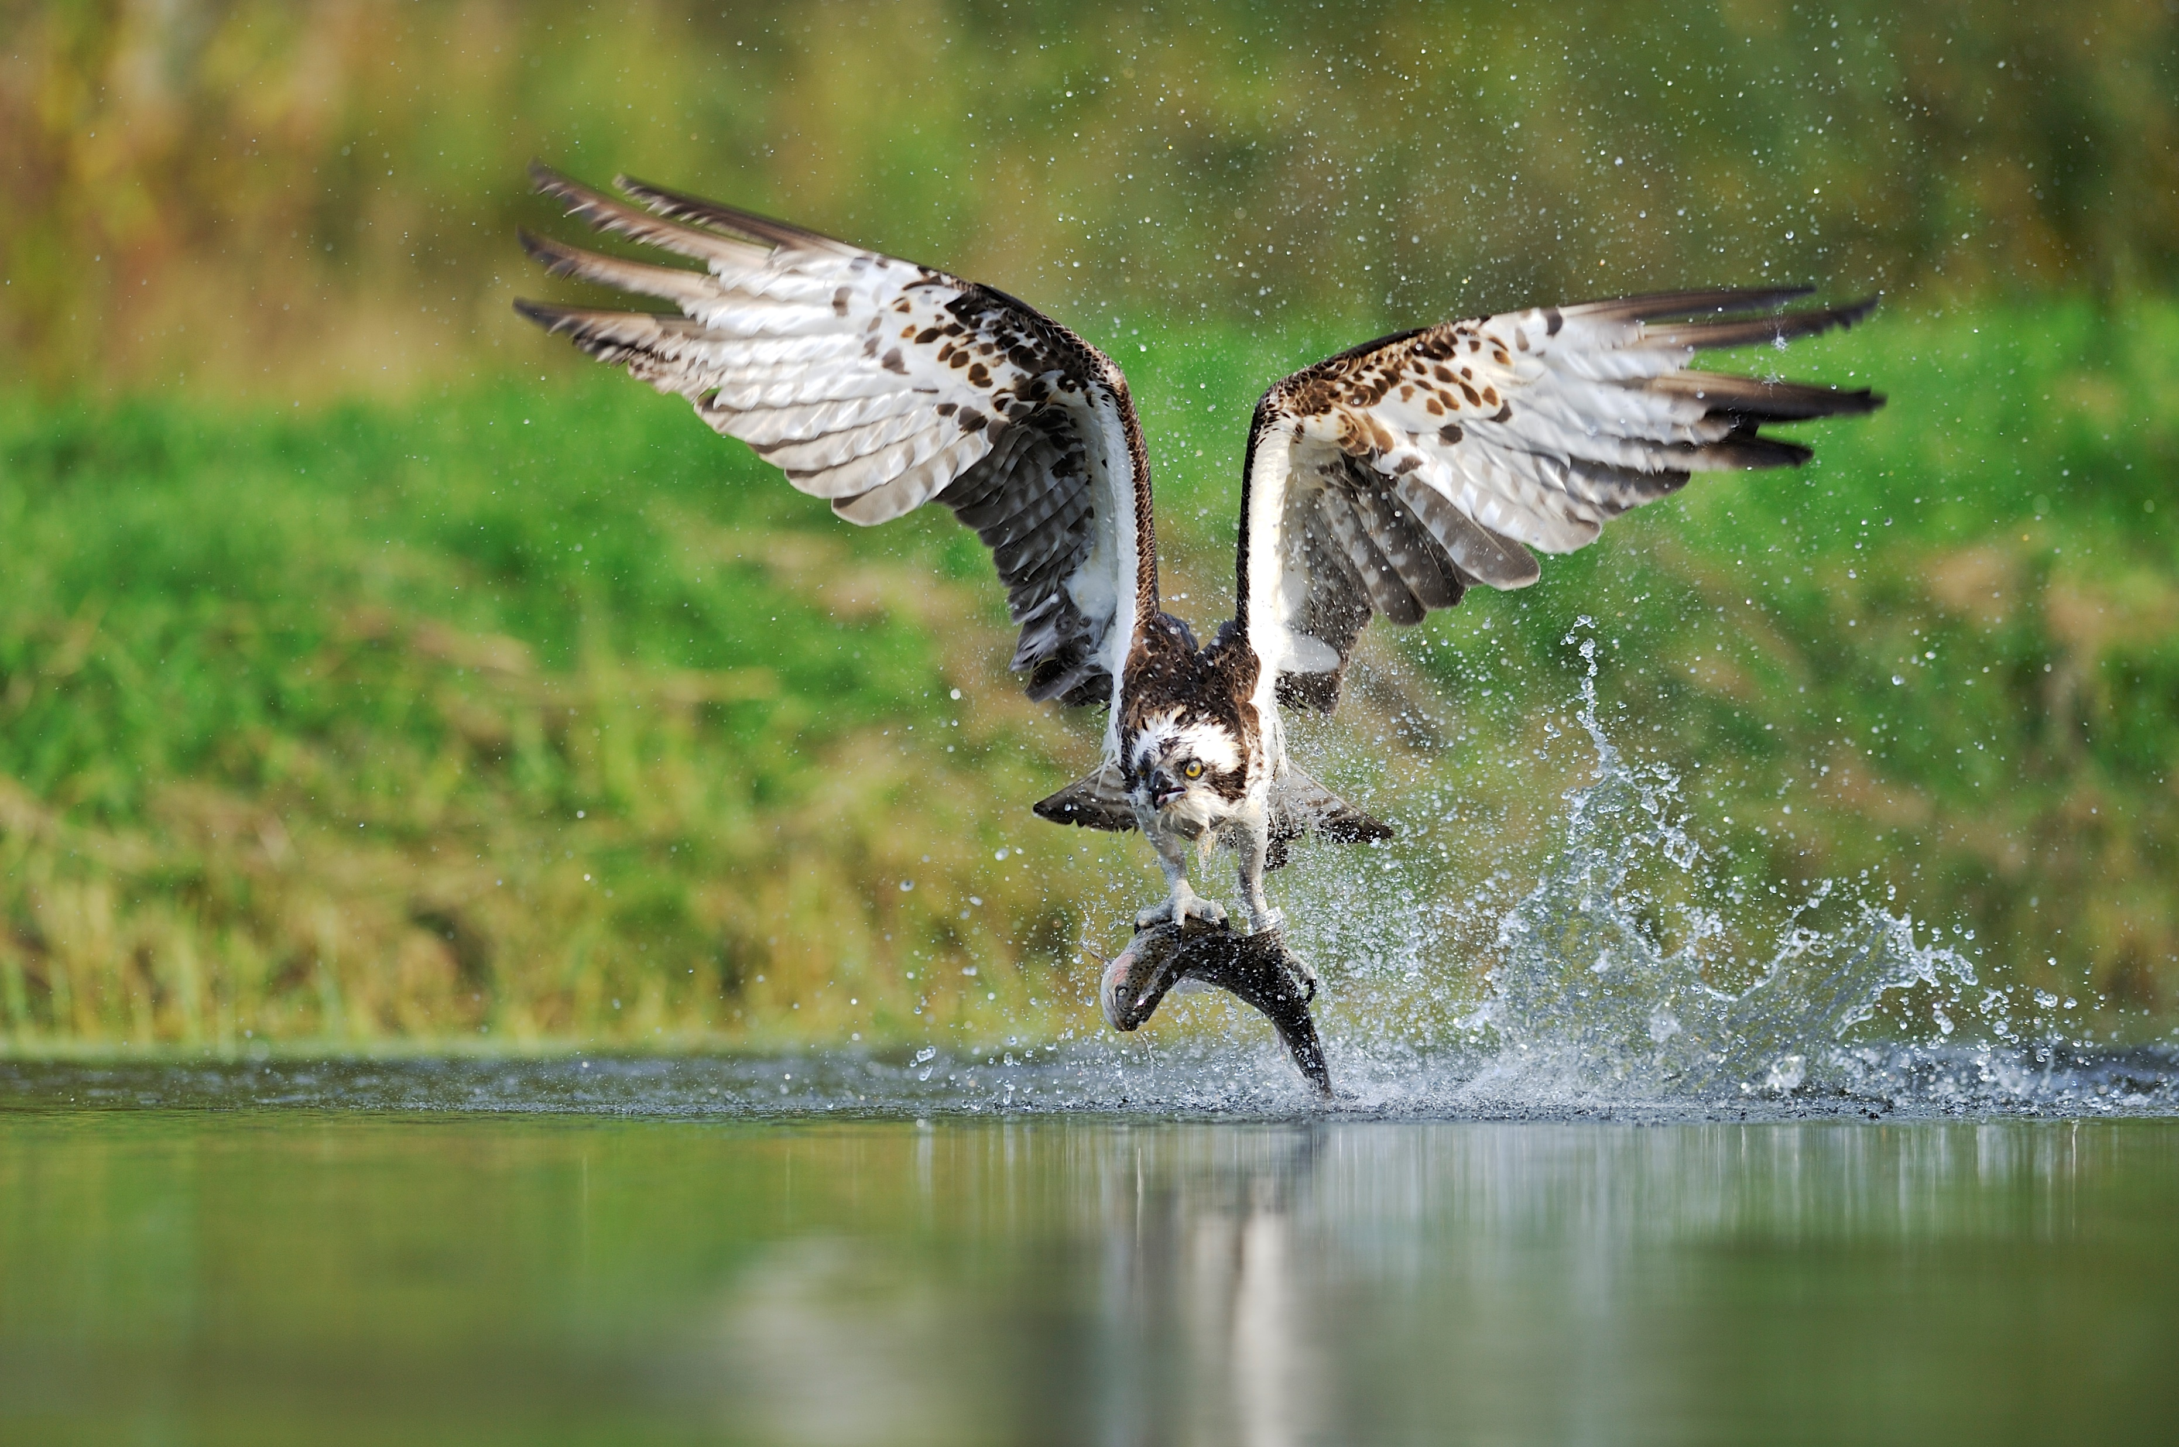
LADY – The Special Osprey

Slide 3

Extended Summary – Key Points to Remember
You will be penalised for writing more than the word limit (maximum 4/5m for language). Anything after 120th word WILL NOT BE marked even if valid content points come after the 120th word
If two aspects are included in the summary question, it is advisable to write two paragraphs connected with a proper transition word.
Ignoring any one part of a two-part question can get maximum of 3 marks for language.
No heading is required for the summary.
Marks will be awarded for content points (6 marks) even if you lift from the text.

Slide 4
Extended Summary – Key Points to Remember
To score above 3 (up to 5 marks) for language, you should show a reasonable attempt of using own words while sequencing your points and making the flow smoother by using linking words.
Candidates are advised to read the summary question very carefully and keep checking with the question.
Underlining points in the text is acceptable and it is advisable to label the points separately if it is a two-aspect question.

Slide 5
Extended Summary – Lady
Take a look at the text.
Underline and label the content points. There is no need to write down the summary.
You must find at least 6 content points. If you can, find more.

Slide 6
Extended Summary – Lady
1) is 26 years old
2) has produced 48 baby birds
3) has outlived 2 mates
4) has returned to her nest for 19 years
5) survived her illness
6) has a unique defect in her eye
7) challenges all that was thought to be true about ospreys
8) no other osprey has ever been observed as much as Lady / last year 33 000 viewed her / this year 120 000 viewed her / has been observed by many people
9) has encouraged a new interest in the survival of the osprey

Slide 7
Summary Writing – How is an extended is summary graded.
0 Marks | No understanding of the task/no relevant content / meaning completely obscure due to serious language inaccuracies.
1 Mark | Copying without discrimination from text/multiple language inaccuracies.
2 Mark | Heavy reliance on language from the text with no attempt to organise and sequence points cohesively/limited language expression making meaning at times unclear.
3 Mark | Some reliance on language from the text, but with an attempt to organise and sequence points cohesively/language satisfactory, but with some inaccuracies.
4 Mark | Good attempt to use own words and to organise and sequence points cohesively generally good control of language.
5 Mark | Good, concise summary style / very good attempt to use own words and to organise and sequence points cohesively.

Slide 8
Extended Summary – Lady
Each group will be given 3 sample responses based on the text and a copy of the marking scheme.
Award marks to each student. 6 marks for content and 5 marks for language.
You have 15 minutes.

Slide 9
Lady – The Special Osprey Sample Response 1
However, a huge birds of prey called an osprey. who is standing in her giant nest and is looking out to the blue sky. Futher more due to the land any day after a 3.000 - mile migration back from west Africa. More over Lady will probably assume that he has died and move on to another male. However Lady is a star attraction and very important. She has a unique defect in the iris of her right eye. Mey be the branches around her are two discreet cameras. one for day and one for night pointing at the nest. The last pair was killed by egg and bird hunters such as the victorian Collector. (117 Words)
Content : The student has only written one valid content point. The rest of the text does not fulfill the question. The valid content point has been lifted directly from the text without any attempt at using own words. Therefore scores 1 out 6 for content.
Language: Most of the text has been copied directly from the text. The student has tried to use some linking verbs. The piece makes sense even though there are many errors. However, it must be noted that the text does not contain the required content. Therefore 1 out 5 for language.
Scores 2 out of 11

Slide 10
Lady – The Special Osprey Sample Response 2
Lady, a huge bird of prey called an osprey. This bird as puzzled the expert by living to the age of 26 and amazing thing is she has produced 48 bay birds. Ospreys mate for life, if one died they would move on to another male. Like this the Lady has outlived two mates. Moreover, she has been coming back to her nest for 19 years. Lady don’t have any mark or ring for the identification. The only way is when bird-watchers focused their cameras on her eyes, that her identity could be confirmed. She has a unique defect in the iris of her right eye which looks like a lightning bolt. (112 Words)
Content: From a content point of view the student has made a good attempt. 5 content points are seen and all are credited. Therefore 5 out of 6.
Language: From a language point of the student has heavily relied on copying from the text without discrimination. Therefore 2 out of 5 for language.
Scores 7 out of 11

Slide 11
Lady – The Special Osprey Sample Response 3
Lady, an osprey has lived to the age of 26. This is astonishing, as ospreys usually live for only 8 years. She has produced 48 baby birds, and has already outlived two lifetime mates. Last year, Lady was ill and thought of to be dead soon, but she survived and came this year. Recognizing Lady is easy, as she as a unique defect in the iris of her right eye, which looks like a lightning bolt. Since her return, enthusiasts have been watching her; no other osprey has been watched by so many people. Worldwide she has encouraged a new interest in the survival of the osprey, which has been under threat for many years. (114 Words)
Content: The student has written 7 content points. More than what is required. It is a very good thing to do as long as the word limit does not exceed. Excellent. Scores 6 out of 6.
Language: The student has written a good concise summary, and has made a very good attempt to use own words and to organise the points cohesively. Scores 5 out of 5 for language.
Scores 11 out of 11

Slide 12
Extended Summary – Lady
Thank You!

